Slide 1
CFE-IPU TW Weekly Update

Slide 2
Job assignment and bandwidth (6.85/7.35/8) (6.85/7.35/8) (Regular/Peak/Total)
Jamie Chou: SRF/EGS/Legacy PLR/IPU validation lead (0.95/0.95)
General Cluster Validation lead in CFE-IPU TWN
Caty Lee: EGS/Legacy/SRF PLR/IPU orchestration lead (0.75/0.5), Automation development (0.2/0.4)
Orchestration lead for SRF/EGS/Legacy execution
Automation innovation and implementation
Cluster infrastructure planning, design, and deployment.
SysDebug Automation support
Nelson Lin: Sirloin workflow engine development (0.7/0.9)
Orchestration lead for Legacy execution
SaaS/PaaS/Automation framework (Airflow) architect
Automation framework (Airflow) planning, design, and development.
Eric Lei: BKC & EGS/Legacy Benchtop Integration PLR/IPU orchestrator (0.35/0.5), Automation development (0.4/0.4)
BKC benchtop Integration for Legacy (1st phase)
BKC benchtop Integration for EGS (2nd phase)
Optimize the execution for EGS benchtop and move things into Cluster
AWS Solution architect
Automation task development, implementation, and maintenance
Matt Lin: SRF/EGS/Legacy PLR/IPU L1/L2 Triage Lead / SysDebug support (0.8/0.9)
Cluster Level1/Level2 Triage lead
Cluster SysDebug support
Sharon Chien: SRF/EGS/Legacy PLR/IPU L1/L2 Triage / SysDebug support (0.9/0.9)
Cluster Level1/Level2 Triage engineer
Cluster SysDebug support
Asus Huang: BHS CFE-IPU TWN/BDC data engineer (0.9/0.95)
Data analysis and Dashboards development
Data team’s rep in Taiwan
Kyle Loh: BHS NPI/PLR/IPU L3 memory debug lead cross all platforms (0.9/0.95)
Memory L3 debug
Memory dashboard and telemetry improvements
Assumptions
Validation Execution CW (1/3)
Triage/SysDebug CW (1/3)

Slide 3
Fleet Weekly Update(WW21)
Program Status
Program | Status for this week | Plan for this week/TODO
SRF-AP (20) | 9 nodes BurnIn finished. 7 nodes are still in the execution of BurnIn. 1 node is NTR.
SRF-SP (229)
EMR (50) | Planned to shutdown all SPR/EMR nodes from WW24.3(EOD) to WW24.5 due to a UPS failure issue has been postponed. New date is unknown so far. IPU25.3 OS image creation is blocked by Artifactory issue | Begin to update free nodes to IPU25.3
SPR (50) | Planned to shutdown all SPR/EMR nodes from WW24.3(EOD) to WW24.5 due to a UPS failure issue has been postponed. New date is unknown so far. IPU25.3 OS image creation is blocked by Artifactory issue | Begin to update free nodes to IPU25.3
CLX (32)
SKX (28)
ICX (50)

Slide 4
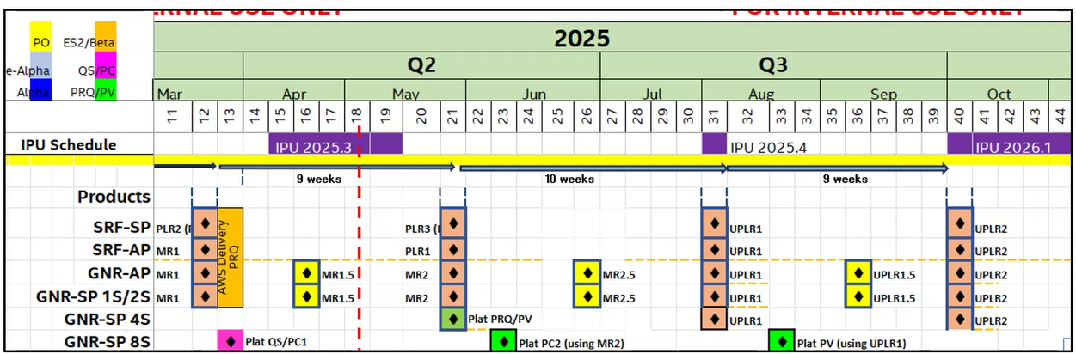
BHS Schedule

Slide 5
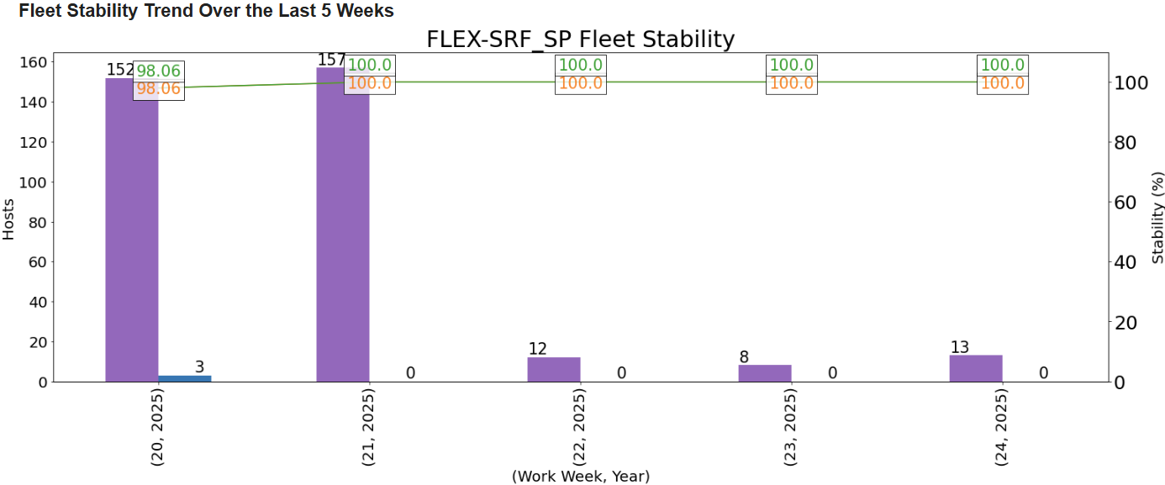
Triage/Debug Weekly Update – PLR3/SRF-SP (ww24)
Status of This Week
Key Update:
NRN status: Opened – 0, Valid – 0, Rejected/Invalid – 0
Auto-HSD issues (NRN excluded): Opened – 0, Valid – 0, Rejected/Invalid - 0
Key Sighting/Pre-sighting status:
Tried to recreate this issue running 3 cycles of 3*TTF over 1 week, issue still cannot be reproduced. Agreed to reject it as cannot_repro by sysdebug lead
WI of Next Week & Help Needed:
NA
SRF-SP- NotReady Status
State of the nodes | WW23.1 | WW23.2 | WW23.3 | WW23.4 | WW23.5
NRN Reported | 1 | 0 | 0 | 0 | 0
Nodes back to execution | 0 | 0 | 0 | 0 | 0
Nodes in triage | 0 | 0 | 0 | 0 | 0
Nodes in INF | 0 | 0 | 0 | 0 | 0
Nodes Moved to debug | 0 | 0 | 0 | 0 | 0
Invalid / not triage & back to execution | 0 | 0 | 0 | 0 | 0
Sl.no | Id | Title | Status / comment
1 | 14024938608 | Kernel panic - not!syncing: Faual exceqtion" + Call Trace;" + ? exc_general_protection+1x246/0x540" + general protection fault, maybe for address 0x10000: 0000 [#1] PREEMPT SMP NOPTI" + RIP: 0010:mas_node_count_gfp+0x10/0x40 during paiv-mixer | Node Impact: 1 Rejected as cannot_repro
2
3
4

Slide 6
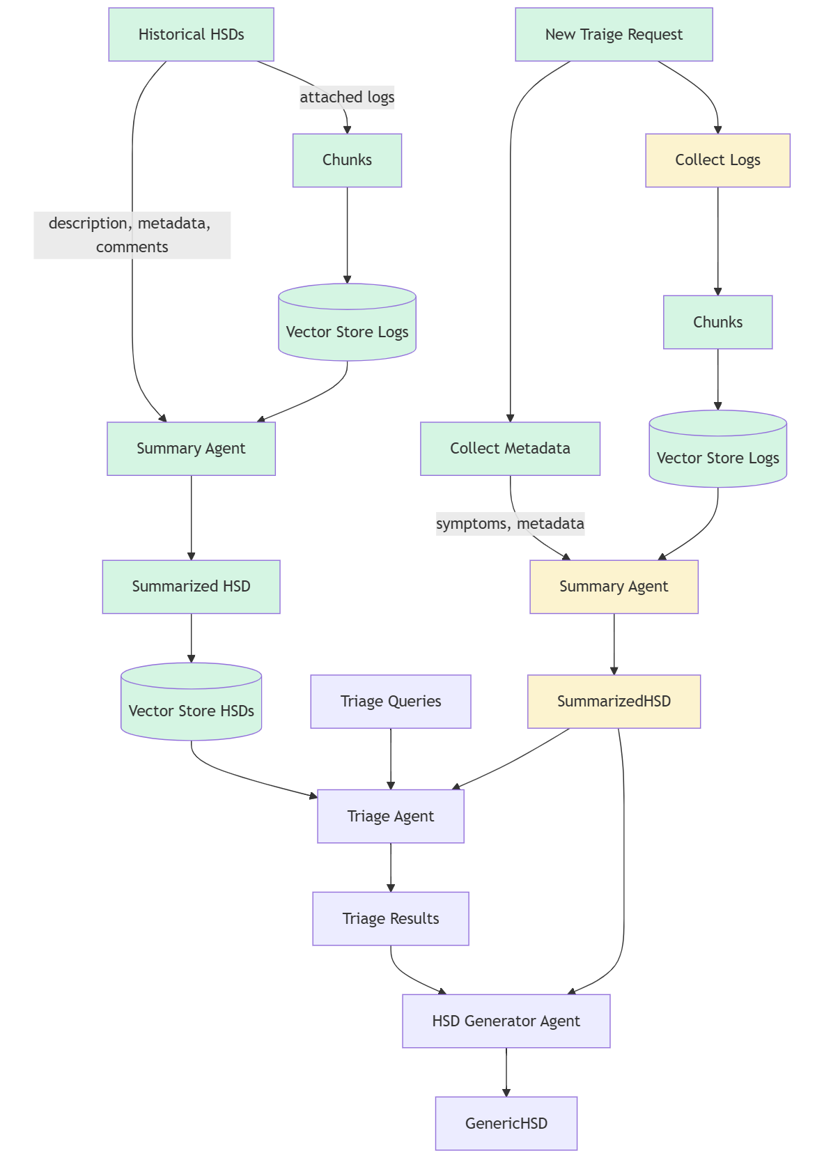
AutoTriage
 | Implemented
 | Work in progress
 | Planned
AutoTriage Agent Status
# | Module | ETA | Status
1 | RAG core functions (Asus) | Q2 | Done
2 | Vector-store database for Logs and HSDs (Asus) | Q2 | Done
3 | Metadata collection for new generic HSD (Caty/Sharon) | Q2 | Done
4 | Historical HSD summarizer (Asus/Sharon) | Q2 | Done
5 | Index historical HSDs (Asus/Sharon) | Q3 | Done for SRF-SP
6 | Triage record summarizer (Asus/Sharon) | Q3 | WIP
7 | Triage result generator (Asus/Sharon) | Q3 | Waiting for #6
8 | Update generic HSD (Setu) | Q3 | Waiting for #7
AutoTriage Issue Tracking
https://wiki.ith.intel.com/display/ScaleCluster/AutoTriage+Issue+Tracking
Type | Priority | Issue | Reported By | Status

Slide 7
Automation in MR/IPU/NPI
New | New Feature/Need to implement
WIP | Working in progress
Done | Implemented
N/A | Not Applicable
*1 Dependency is Burnin Memory Test Tracker and Memory Dashboard depends on CWF-AP telemetry function to be ready
* Cluster Scope retirement vs PSE Console readiness
Automation Task | MR/PLR/IPU |  |  |  |  |  | NPI
 | ICX | SPR | EMR | SRF-AP | SRF-SP | GNR-AP/SP | CWF-AP | CWF(BHS) | AI Systems | DMR
NRN Report (Eric) | N/A | Done | Done | Done | Done | Done | Done | Done | Unknown | Unknown
Cluster scope advanced console. | Done | Done | Done | Done | Done | Done | Done | Done
Generic HSD (Phoenix/Eric) | N/A | Done | Done | Done | Done | Done | Done | Done
MergeHSD (Asus) | New | Done | Done | Done | Done | Done | Done | Done
AutoTriage (Phoenix/Asus) | New | Done | Done | Done | Done | Done | Done | Done
PythonSV Auto (Nelson) | New | Done | New | Done | Done | Done | Done | Done
Burnin Memory Tests Tracker (Eric) | N/A | Done | Done | Done | Done | Done | WIP*1 | WIP*1
CPU Workload Tracker (Eric) | N/A | Done | Done | Done | Done | Done | Done | Done
Daily Node Status Report (Caty) | Done | Done | Done | Done | Done | Done | Done | Done
Tests / Failures Dashboards (Asus) | Done | Done | Done | Done | Done | Done | Done | Done | Done | Done
Memory Dashboards (Asus/Kyle) | N/A | Done | Done | Done | Done | Done | Unknown*1 | Unknown*1 | Unknown | Unknown
Test Summary Report (Caty/Eric) | N/A | Done | N/A | Done | Done | Done | Done | Done
WARM DOWN MODE

Slide 8
Automation in MR/IPU/NPI
*1 : Too many IO and Memory configures combination and make original design and implementation difficultly. Need to adopt new design to resolve them.
*2 : Because SRF-AP and SPR have finished the prechecking and preconfigure processes based on old fashion, they don’t need to migrate to new method necessarily.
*3 : AT stands for Auto-Trigger project
New | New Feature/Need to implement
WIP | Working in progress
Done | Implemented
N/A | Not Applicable
Automation Task |  |  | MR/PLR/IPU |  |  |  |  |  | NPI
 |  |  | ICX | SPR | EMR | SRF-AP | SRF-SP | GNR-AP/SP | CWF-AP | CWF(BHS) | AI Systems | DMR
Auto-Trigger/Auto Execution | Core | RDY | Done |  |  |  |  |  |  |  |  | Unknown
 | Core | Resume/Rerun | Done
 | Core | COM/Go next | Done
 | Core | BAT | Done
 | DPMO | Configure | New | New | New | Done | Done | Done | New | New | Unknown
 | BAT | Configuration & Integration |  |  |  | Done | Done | New | Done | Done
 | Jenkins | AT*³ Configuration | New | New | New | Done | Done | Done | Done | Done
 | Jenkins | BKC Burnin Pipeline Integration | New | New | New | Done | Done | Done | Done | Done
 | Jenkins | Burnin Pipeline integration | New | Done | New | Done | Done | Done | Done | Done
 | Jenkins | Main1 Pipeline Integration | New | Done | New | Done | Done | Done | Done | Done
 | Jenkins | Main 2 Pipeline Integration | New | Done | New | Done | Done | Done | Done | Done
 | Jenkins | Sample Factory Pipeline Integration | N/A | N/A | New | Done | Done | Done | New | New
 | Jenkins | PNP Pipeline Integration | New | Done | New | Done | Done | N/A | Done | Done
 | Executable | Precheck & preconfig | New | Done | New | Done | Done | WIP | WIP | WIP
 | Enhance | Standardisze IO/Memory profile records | Done
 | Enhance | Support IO/Memory config check | Done
 | Enhance | Construct Node IO/Memory info baseline before execution and each test step | PLAN
 | Enhance | IO config check | New | Low Priority*² | New | New | Low Priority*² | WIP | WIP | WIP | Unknown
 | Enhance | Memory config check | New |  | New | New |  | WIP | WIP | WIP
WARM DOWN MODE
2nd priority
1st priority

Slide 9
Backup

Slide 10
BKC and Benchtop TC Integration
Program Status
Program | Status for this week | Plan for this week/TODO
BKC Execution | Domain owners are reviewing TCs for integration | NA
EGS benchtop integration | Sundar to provide TCs | NA
Plan to start BKC TCs with below criteria: (108/738)
automation_potential: Fully Automate
operating_system: Non Windows
test_steps: With clear test steps
Domain | TC Counts | Readiness
Io_pcie | 2 | 0
manageability | 1 | 0
Memory | 15 | 0
power_and_perf | 59 | 41
power_management | 3 | 0
processor_core | 3 | 0
ras | 2 | 0
security.sgx | 12 | 0
sw_fw_update.seamless | 1 | 0
virtualization | 10 | 0
Total | 108 | 41

Slide 11
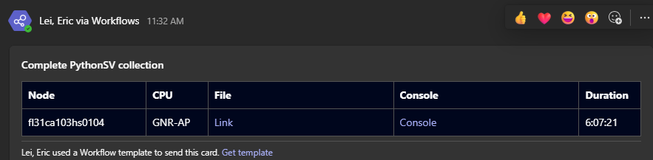
Case Study: Stop on Failure for Memory Debug
import subprocess itp.log('/home/{idsid}/{node}_pythonsv_{formatted_date}_showerrors.log') subprocess.run(['cat', '/home/{idsid}/{node}_pythonsv_{formatted_date}_showerrors.log']) import graniterapids.mc.gnrMcUtils as mu mu.show_errors() nolog() sv.sockets.soc.ddrphy.logregisters('/home/{idsid}/{node}_pythonsv_{formatted_date}_ddrphy.log') subprocess.run(['cat', '/home/{idsid}/{node}_pythonsv_{formatted_date}_ddrphy.log']) sv.sockets.soc.memss.logregisters('/home/{idsid}/{node}_pythonsv_{formatted_date}_ddrmemss.log') subprocess.run(['cat', '/home/{idsid}/{node}_pythonsv_{formatted_date}_ddrmemss.log']) from {platform}.toolext import status_scope status_scope.run(collectors=['namednodes'], analyzers=["auto"]) halt()
Monitor registers for SUTs through Prometheus.
ras_mc_shadow_cor_err_count
ras_mc_shadow_uc_bit_set
PythonSV commands will be run on SUTs if above condition met. Please see PythonSV commands in right-hand side.
Currently only for memory debug. Can be extended for more use cases.
Support BHS (GNR-AP/SP and SRF-AP/SP)
Send Teams notification in real time.

Slide 12
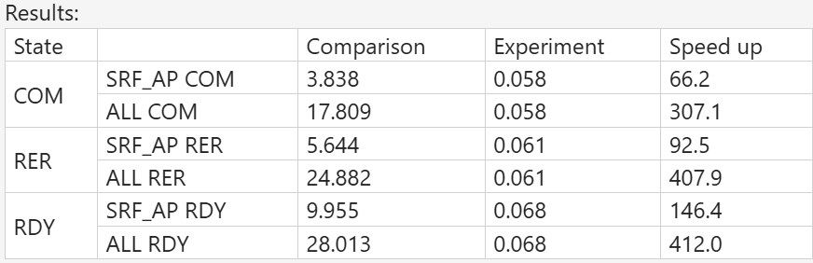
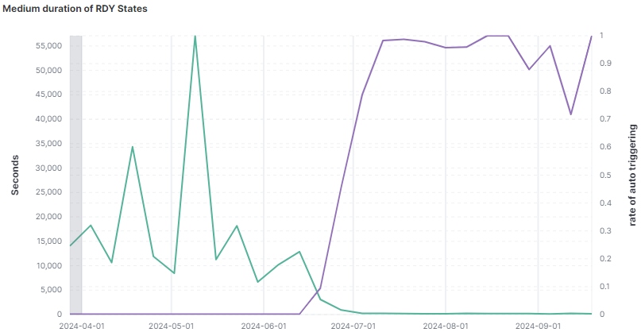
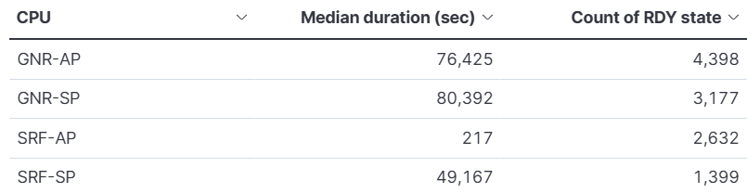
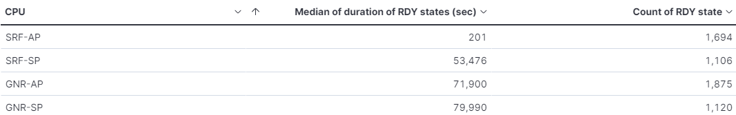
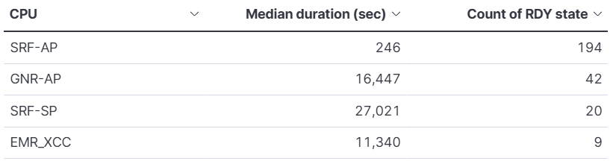
Speed up validation by automated operation flow
Significant speed-up achievements : Overall gets 99.7% more efficient:
464x in Ready (RDY) states transition
408x in ReRun (RER) states transition
24.8 hrs 219 seconds
307x in Complete (COM) states transition
17.8 hrs 208.8 seconds
0 delay on PythonSV log collection
0 delay on HSDs generation for not-ready nodes triage.
NO HUMAN INVOVED
NO WAITING TIME
Duration of RDY states while AutoTrigger is applied
28 hours
217 seconds
Apply rate
Comparison of efficiency to the other platforms
340.2x improvement in efficiency reduced the median time from system delivery(RDY) to execution tests(EXC), from 19hrs to 201 secs.
0 waiting time for results of PythonSV log collecting.
And we can expect that
214.9x from test completed(COM) to execute the next tests automatically(RDY)
232.8x from triage (RER) to resuming execution tests(EXC)
0 time-consumption to create the generic HSD for NotReady Nodes. (Save 4 hour/day for Triage engineers*)
Duration
(Save 4 hour/day/triage engineer)
The statistics is based on the data from 24,7/01-25,02/11
Notes:
Comparison Time range: 2024-07-01 ~ 2024-12-31 Filter: (Not autotriggered) AND (Ended) AND (NOT phoenix_pool:*PCE*)
Experiment Time range: 2025-02-01 ~ 2025-02-12 Filter: (SRF-AP) AND (autotriggered) AND (Ended) AND (NOT phoenix_pool:*PCE*)
Results:

Slide 13
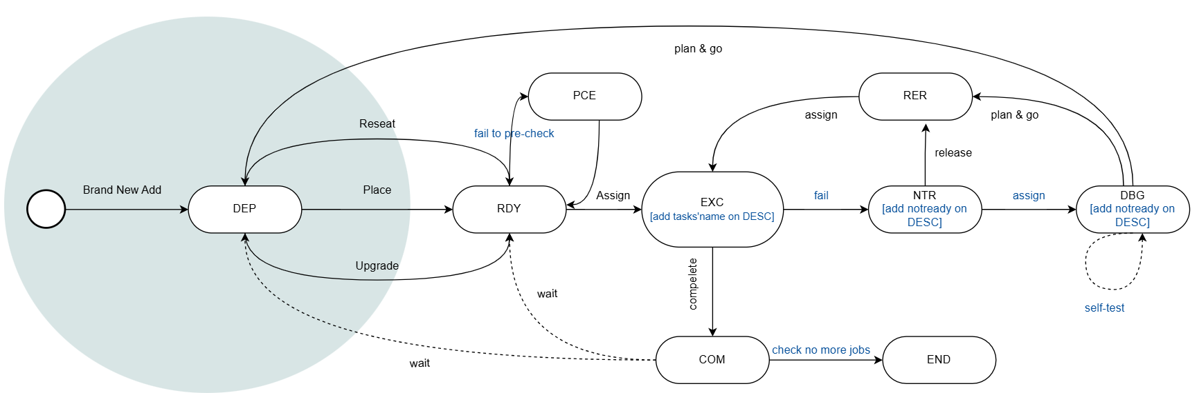
Speed-up state transitions
408x
464x
307x

Slide 14
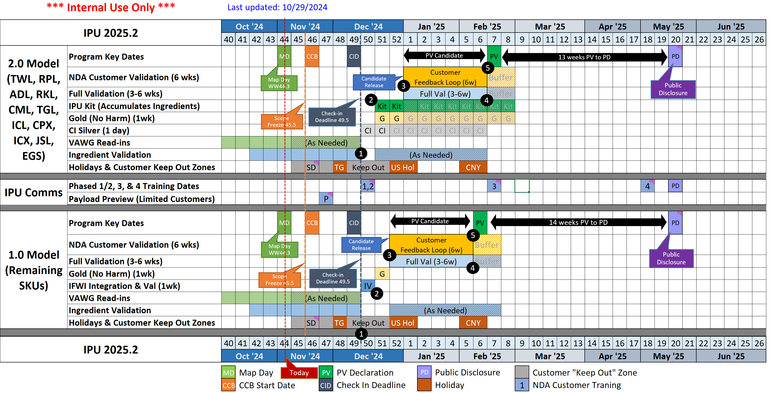
IPU 2025.2 Baseline Schedule
Notes:
(1) WW49.5 Check-in Deadline for all products
(3) WW52.5 Candidate Releases
CI Loop runs in parallel with Full validation
(4) We use Buffer only when needed
(5) WW06-07 PV Declarations

Slide 15
Triage/Debug Weekly Update – PLR/SRF-SP (ww10)
IOSF issue status: [Cluster][FLEX SRF_SP C0][Multi-nodes][2S] [Master] IOMCA error from Global IEH|IOSF error|{'BUS': '0x3a', 'DEV': '0x2', 'FUNC': '0x0'}|IOMCA (from BUS=0x3a, DEV=0x2, FUNC=0x0) + McBankErrorHandler: Skt = 0x0, McBank = 0x4, State = 0x2 during ptg-test/dtaf-functional
 | Node | IO Config | Sub-test | PLR2 BKC#99 | BKC#98 | PCIe Port | PCIe Device w/ IOSF Error | Current state | Next step
1 | fl31ca102gs0906 | IO14 | ptg test | WIP | Failed | Socket0.pxp2.port0 | RPB | WW 10-2 Triggered test with PLR2 on WW 10-2 WW10-1 Raised Jira for reflashing PLR2 on this node. https://jira.devtools.intel.com/browse/ASCGA-22326 WW9-6 Currently cxl-P0top1-p1top1-s0tohdm1-s1-hdm0 test running, from last 2day test is running there is no issue reported | Ww10.2 –Waiting for issue repro with PLR2 Ww10.1 –Need trigger test with PLR2. Ww9.5 –After replacing the RPB card waiting for issue reproduction
2 | fl31ca105as0704 | IO14 | test-end-indicator","dtaf-functional-qd48g" | Failed | Passed | Socket1.pxp2.port0 | Mellanox CX7 | WW 10-2 Triggered test with PLR2 on WW 10-2 test running from last 8 hrs, issue reproduced WW10-1 Raised Jira for flashing PLR2 on this node. https://jira.devtools.intel.com/browse/ASCGA-22326 WW9-6- With PLR1 BKC test completed without any issue, so as per discussion with PCIE surprise link down enable we started the test on 9.6 | Ww10.2 – under collecting the test results Ww10.1 –Need trigger test with PLR2. ww9-6- with PLR1 BKC PCIE surprise link down enable started the test waiting for result
3 | fl31ca105as0604 | IO14 | dtaf-functional-mprgn | Failed | Failed | Socket1.pxp2.port0 | Mellanox CX7 | WW10-2 re-trigger test with PLR1 IFWI + 0341(PLR2 microcode) WW10-1 triggered test with IOMCA Disable WW9-6- After mellanox card replacement retriggered the testwith PLR2 issue reported with PLR2 after replaced the mellonox card so with PCIE surprise link down disable started the test | Ww10.2 –Waiting for issue repro Ww10.1 –Waiting for issue repro WW9-6 Waiting for test to complete or issue reproduction
4 | fl31ca105as0102 | IO14 | Cold_reset_redfish | Failed | Passed | TBD | Need to check | WW 10-2 re-trigger test with PLR2 IFWI + 0330(PLR1 microcode) raised jira for flashing IFWI WW10-1 Test Running without any issue after 680 cycles | Ww10.2 –Need to run the test once node is back from EVF Ww10.1 –Waiting for issue repro
5 | fl31ca105as0503 | IO14 | ptg test | Failed | Passed | Socket1.pxp2.port0 | Mellanox CX7 | WW 10-2 Triggered test with PLR2 on WW 10-2 WW10-1 Raised Jira for flashing PLR2 on this node. https://jira.devtools.intel.com/browse/ASCGA-22326 | Ww10.2 –Waiting for issue repro with PLR2 Ww10.1 –Need trigger test with PLR2.
6 | fl31ca105as0702 | IO14 | ptg test | Failed | Passed | Socket1.pxp2.port0 | Mellanox CX7 | WW 10-2 Triggered test with PLR2 on WW 10-2 WW10-1 Raised Jira for flashing PLR2 on this node. https://jira.devtools.intel.com/browse/ASCGA-22326 | Ww10.2 –Waiting for issue repro with PLR2 Ww10.1 –Need trigger test with PLR2.
7 | fl31ca105as0602 | IO14 | ptg test | Failed | Not Test yet | NA | NA | WW10-2 Issue reported 2 nd time and enabled itp.break value =1 and triggered the test WW10-1 Retriggered test for issue reproduction, TTF is 2d 10h | Ww10.2 –Issue not reproduced yet test running from last 6hrs Ww10.1 –Waiting for issue repro
8 | fl31ca105as0701 | IO14 | cxl-p0top1-p1top1-s0tohdm1-s1tohdm0- | Failed | Not Test yet | NA | NA | WW10-2 Test running from last 1 day issue not reproduced yet WW10-1 Retriggered test for issue reproduction, TTF is 2d 10h | Ww10.2 –Waiting for issue repro Ww10.1 –Waiting for issue repro

Slide 16
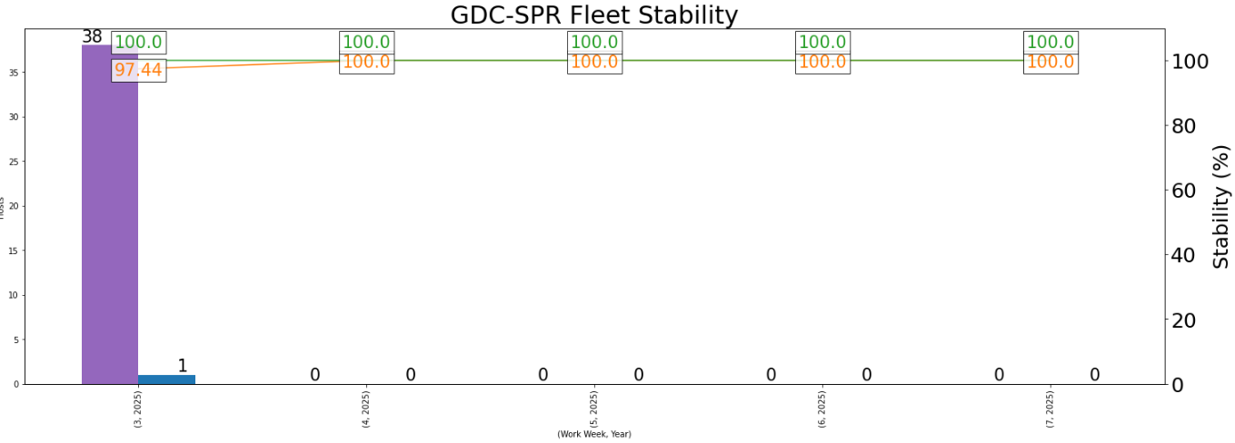
Triage/Debug Weekly Update – IPU (ww06)
Status of This Week
Key Update:
IPU 25.2 – SPR/ICX
In warm down mode
No NRNs reported in WW06
Auto triage APP trial run (WIP, Owner: CW lead)
WI of Next Week & Help Needed:
NA
SPR- NotReady Status
State of the nodes | WW06.1 | WW06.2 | WW06.3 | WW06.4 | WW06.5
NRN Reported | 0 | 0 | 0 | 0 | 0
Nodes back to execution | 0 | 0 | 0 | 0 | 0
Nodes in triage | 0 | 0 | 0 | 0 | 0
Nodes in INF | 0 | 0 | 0 | 0 | 0
Nodes Moved to debug | 0 | 0 | 0 | 0 | 0
 | Last test-Subtest | HSD | Issue/Comment | Next Step
1
2

Slide 17
Automation in IPU/NPI
New | New Feature/Need to implement
WIP | Working in progress
Done | Implemented
N/A | Not Applicable
Automation Task |  |  | PLR/IPU |  |  |  | NPI
 |  |  | ICX | SPR | EMR | SRF-SP | SRF-AP | GNR-AP/SP | CWF-AP | AI Systems
Auto-Trigger/Auto Execution | Core | RDY | Done
 | Core | Resume/Rerun | Done
 | Core | COM/Go next | Done
 | DPMO | Configure | New | New | New | WIP | Done | WIP | Unknown | Unknown
 | Jenkins | AT Configuration | New | New | New | WIP | Done | WIP
 | Jenkins | Pipeline integration | New | New | New | Done | Done | WIP 50%
 | Executable | Precheck & preconfig | New | Done | New | WIP*¹ | Done | New
 | Enhance | Support IO/Memory config check | PLAN
 | Enhance | IO config check | New | Low Priority*² | New | New | Low Priority*² | New | Unknown | Unknown
 | Enhance | Memory config check | New |  | New | New |  | New
*1 : Too many IO and Memory configure

Slide 18
BHS-SRF-AP Fleet Stability Impact – WW48’24
Fixed in latest BKC/HW
Root Caused
Debug WIP
New Issue
Fleet 94.44% (BMC excl’d *) Total of system ran =18 Passing 17 (94.44%), Failed 1 (5.56%)​
Failure Type​ | Impact to Fleet Stability​ | Top issues ​ [sighting closure path/status]​ | Sightings​
Critical events reported by BMC​ | 0% FLEX-SRF_AP​
KernelPanics ​ | 0% FLEX-SRF_AP​
MCEs​ | 5.6% FLEX-SRF_AP​ | 1. MCE Without Reboot McBankErrorHandler: Skt = 0x0, McBank = 0x1, State = 0x1 MC status 0x8C200045D52F110A, class CORRECTED, MSCOD d52f [1] Node [3.6%] single hit, under repro | 14023888643
IERR/ Crashes / Others​ | 0% FLEX-SRF_AP​

Slide 19
Google IPS Statistics – EGS all IPS
PO
Beta
QS
PRQ
Certain defects arising from the manufacturing stages 2. Combine DIMM defects (varied rank/size in the 2DCP configuration)
Integrate TDX/PnP testing content

Slide 20
SRF-AP Pre-sightings/Sightings Update – WW39
PO
Alpha
Beta
QS
Failure type | Master HSD | Report Type | Title | Status | Pipeline (test) | SRF-AP Specific | Tencent 1S Impact | Remark
IERR/MCERR/Others | 14022321282 | Sighting | [Cluster][FLEX GNR AP B0/ SP ES2 SRF SP/AP][Master] Node stuck with PostCode 0x03"Failed to find matching CPU ID on the list" during " AC/Cold/Warm" cycles | Open.assigned | DPMO - warm (power cycling) | no | unknown | under debug
IERR/MCERR/Others | 18038372532 | Sighting | [SRF All, GNR All B*] PECI Wire Commands Result with 0x83 Responses (one 0x83 response per 50000 commands) | Open.root_caused | basic acceptance test | no | unknown | will be closed as won't fix
MCE Without Reboot | 15016203038 | Sighting | [Cluster][FLEX SRF_AP C0][MASTER] UPI MSCOD 0x30 Correctable Errors on Recipe 18 | Completed.product_change | main2 - ive-vt-genie-multi-tenant-v2p0-23ww51-4 | no | unknown
Kernel Panic | 15016405046 | Sighting | [Cluster][FLEX SRF-AP C0][Multiple][Master]Kernel panic - not syncing: Fatal exception in interrupt + Call Trace: RIP: 0010:enqueue_task_fair+0xdf/0x370 during paiv-mixer | Open.transferred | main1 - paiv-mixer | yes | unknown | have not seen the issue on latest execution cycles
BMC Critical Event | 14022408608 | Sighting | [Cluster][FLEX GNR_AP A2]BMC Critical Event Fan sensor crossed a critical low threshold going low during AC cycles | Open.root_caused | DPMO - AC (power cycling) | no | unknown | This issue doesn't have any impact on thermal or hardware (customer do their own BMC implementations)
BMC Critical Event | 15016236163 | Sighting | [GNR SP/AP VV][BKC][2024WW24][X2][2S][Stability]Multiple voltage sensors reading is 0 and SEL record trigger the lower threshold during AC and WR cycling test | Open.transferred | DPMO - AC/Warm (power cycling) | no | unknown | under debug by CPLD team
IERR/MCERR/Others | 14022067944 | Presighting | [Cluster][FLEX SRF_AP C0][Multiple nodes][ES2] LockStep mismatch Error - FRC error McBank = 0x0 - MC status 0xB200000004100004, class FATAL in socket 0/1 in multiple test | Open | Burnin - sandstone-rf-cold & main1/main2 | yes | unknown | 21 units (sightings) hit LockStep mismatch error (FRC error), proceed RPP back to mfg team
BMC Critical Event | 15016608743 | Sighting | BMC Critical Event.Die/DTS_CPU1/2 sensor crossed a critical high threshold going high + Thermal Trip + CPU Error Occurred: CPU 2 early error.. | Open | DPMO - AC (power cycling) | yes | yes | under debug, 1 node with Tencent 1S config

Slide 21
SRF-AP Risk/Gap Assessment Update (WW38)
Item | Task | Description | ARs/Remark | Status
1 | Capability gaps | Capability gap is identified in debug function. For orchestration, gaps in test execution alignment | No debug resource and capability within TWN ASV Team (except mem debug)
2 | HC resource gaps | No comprehensive HCs to be fully in charge of SRF-AP (BDC-SRF-SP 15+ vs. TWN-SRF-AP 3.8*) | Focus on issue triage, debug is not recommended due to low risk
3 | Leverage plan | What is the leverage plan of SRF-SP and SRF-AP delta features in test execution and sightings? | Sample Factory and Burnin test only, leverage existing test pipelines
4 | Automation tools deployment | Understanding of current SRF-AP automation tools is used and see if any need to be improved or deployed | Aligned with whole ASV Team
5 | Debug R&R/process | Understanding of current SRF-AP debug R&R and process | Not applicable
6 | Triage R&R/process | Understanding of current SRF-AP triage R&R and process | Aligned with whole ASV Team
7 | Orch - Pipelines | Deep dive into speicific test contents for SRF-AP, e.g. BKC acceptance test, SHC, MLC etc. | SFT test, DPM (burnin test) and DPMO only
8 | DPMO Strategy | Understanding of current DPMO process and strategy | Aligned with whole ASV Team
9 | Team roster update | What's the workgroup for each function team to support SRF-AP? | Done
10 | Validation Plan/Process update | What's the whole picture of validation plan and process? | SFT test, DPM (burnin test) and DPMO only

Slide 22
BHS-SRF-AP Fleet Stability Impact – WW40’24
Fixed in latest BKC/HW
Root Caused
Debug WIP
New Issue
Fleet 90.11% (BMC excl’d *) Total of system ran =91 Passing 71 (78.02%), Failed 20 (21.98%)​
Failure Type​ | Impact to Fleet Stability​ | Top issues ​ [sighting closure path/status]​ | Sightings​
Critical events reported by BMC​ | 14.3% FLEX-SRF_AP​ | [Cluster][FLEX SRF_AP C0][MASTER] VR sensors 0V during power cycle [4/4] Q5ZD impacted [4.3%] issue still reproducible with lower rate, ADC is providing 0 to cpld and CPLD is providing same values to BMC. Issue still under investigation by CPLD team 2.[Cluster][FLEX GNR_AP A2]BMC Critical Event Fan sensor crossed a critical low threshold going low during AC/cold cycles [7/7] Q5ZD impacted [7.7%] CPLD fix is under verification WIP 3. [Cluster][FLEX SRF_AP C0][fl31ca303bs0408] BMC Critical Event PSU1_Input_Power sensor crossed a critical high threshold going high [0/1] Q5ZD impacted [1.0%] Single hit, under repro 4. [Cluster][FLEX SRF_AP C0][fl31ca303bs0403][1S] Node off at PostCode: 0x05 + System power good failed to assert within 12000 milliseconds (VR failure) during DPMO Cold_Reset_Redfish [1/1] Q5ZD impacted [1.0%] Single hit, issue can be replicated, seeking for debug support from L3 | 15016236163 14022408608​​ 14023530311 14023560855
KernelPanics ​ | 5.5% FLEX-SRF_AP​ | ​1. [Cluster][FLEX SRF_AP C0][fl31ca303as0402][1S]Node hang with Kernel panic - not syncing: Fatal exception + Call Trace: RIP: 0010:task_mm_cid_work+0xe0/0x230 + DTS/Die_CPU1 sensor crossed a warning high threshold going high during mesh-stress [2/2] Q5ZD impacted [2.2%] under repro 2. [Cluster][FLEX SRF_AP C0][fl31ca302bs0607][2S] Node hang with Kernel panic - not syncing: Fatal exception + Call Trace: 0010:cpuidle_enter_state+0xd0/0x410 during mesh-stress [1/2] Q5ZD impacted [2.2%] known issue, under repro 3. [Cluster][FLEX SRF_AP C0][fl31ca302as1005][1S] Node hang with Kernel panic - not syncing: Fatal exception + Call Trace: RIP: 0010:enqueue_task_fair+0xdf/0x370 during sriov-random-mix [1/1] Q5ZD impacted [1.0%] known issue, 1st time seen on Q5ZD, under repro | 14023573691 14023573689 14023549520
MCEs​ | 0.0% FLEX-SRF_AP​
IERR/ Crashes / Others​ | 5.5% FLEX-SRF_AP​ | 1. [Cluster][FLEX SRF_AP C0][fl31ca303as0104][1S] Bank#3 MEC (mcacod:0x135 desc:Cache Errors: DRD.D.L1) + Bank#4 UBOX (mcacod:0x135 desc:0x135) + Bank#0x13 MCCHAN (mcacod:0xc0 desc:1LM memory controller error, memory scrubbing error, channel 0) during ras-unified [2/2] Q5ZD impacted [2.2%] known issue related to old version ras-unified v18, try to repro with newer versions v32 & v37 2. [Cluster][FLEX SRF_AP C0][fl31ca303bs0208][1S][Master]Node hang with IERR from compute1:core_coregp.0.cpucore.92 during ras-unified [1/1] Q5ZD impacted [1.0%] single hit, under repro 3. [Cluster][FLEX SRF_AP C0][fl31ca303bs0509][1S] Bank#0 BUS (mcacod:0x400 desc:Internal Timer Error: Internal Timer Error) + Bank#4 (Shutdown suppression) during AC_Cycle_Sysman_AF [1/1] Q5ZD impacted [1.0%] single hit, under repro | 14023560849 14023549521 14023562856

Slide 23
BHS-SRF-AP Fleet Stability Impact – WW38’24
Fixed in latest BKC/HW
Root Caused
Debug WIP
New Issue
Fleet 93.42% (BMC incl’d *) Total of system ran =152 Passing 131 (86.18%), Failed 21 (13.81%)​
Failure Type​ | Impact to Fleet Stability​ | Top issues ​ [sighting closure path/status]​ | Sightings​
Critical events reported by BMC​ | 8.5% FLEX-SRF_AP​ | [Cluster][FLEX SRF_AP C0][MASTER] VR sensors 0V during power cycle [5/5] Q5ZD impacted [3.2%] issue still reproducible with lower rate, ADC is providing 0 to cpld and CPLD is providing same values to BMC. Issue still under investigation by CPLD team 2.[Cluster][FLEX GNR_AP A2]BMC Critical Event Fan sensor crossed a critical low threshold going low during AC/cold cycles [1/4] Q5ZD impacted [2.6%] We do need to compare the date reading by BMC vs the fan controller transaction to correlate the reduction of the speed. System instrumented and reproduction WIP​. 3. [Cluster][FLEX SRF AP C0]Node went off with Die/DTS sensor crossed a critical high threshold going high then CPU 2 Thermal Trip during AC_Cycle_Sysman_AF [1/3] Q5ZD impacted [2.0%] under repro 4. [Cluster][FLEX SRF_AP C0][fl31ca303as0208][1S] ﻿Node off at PostCode: 0x03 with Power supply power good failed to assert within 8000 milliseconds during DPMO AC_Cycle_Sysman_AF [1/1] Q5ZD impacted [0.6%] single hit, under repro | 15016236163 14022408608​​ 15016608743 22020477634
KernelPanics ​ | 0.6% FLEX-SRF_AP​ | ​1. Kernel Panic. Kernel panic - not syncing: Fatal exception [0/1] Q5ZD impacted [2.6%] under triage | 14023462899
MCEs​ | 2.6% FLEX-SRF_AP​ | 1 - [Cluster][ FLEX SRF-AP A0][Multiple] McBank0 – Lock Step Compare error - FRC - 0x410 error during paiv-mixer [1/1] Q5ZD impacted [0.6%] known issues, treated as faulty parts ​ 2 - MCE Without Reboot McBankErrorHandler: Skt = 0x0, McBank = 0x5, State = 0x1 MC status 0x8800004400300E0F, class CORRECTED, MSCOD 0030 [0/1] Q5ZD impacted [0.6%] ​ 3 - MCE Without Reboot McBankErrorHandler: Skt = 0x0, McBank = 0x13, State = 0x1 MC status 0x8C00004200800090, class CORRECTED, MSCOD 0080 [1/1] Q5ZD impacted [0.6%] Under reproduction consider single DIMM module issue​ ​ 4 - MCE Without Reboot McBankErrorHandler: Skt = 0x0, McBank = 0x1, State = 0x1 MC status 0x8C2000413D0E110A, class CORRECTED, MSCOD 3d0e [1/1] Q5ZD impacted [0.6%] single hit, Under reproduction | 15016203038​ 14022612770 ​ 14023313970 14023376836
IERR/ Crashes / Others​ | 2.0% FLEX-SRF_AP​ | 1 - [Cluster][FLEX SRF AP C0][fl31ca302as0505][1S] Bank#3 MEC (mcacod:0x135 desc:Cache Errors: DRD.D.L1) + Bank#4 UBOX (Shutdown suppression) + multiple MCCHAN (mcacod:0xa0 desc:1LM memory controller error, memory write error, channel 0) during Warm_Reset_OS [1/1] Q5ZD impacted [0.6%] single hit, under repro 2 -IERR.CPU Error Occurred: IERR on CPU 1 & 2 [0/1] Node[0.6%] under triage 3 - CD IERR.HW.MCE.UBOX:Shutdown_Error:_Mce_Under_Wps.incomplete_dump.mca_zero_value+IERR.CPU Error Occurred: IERR on CPU 1. [1/1] Node[0.6%] under triage | 15016777828​ 14023429240 14023450724

Slide 24
BHS-SRF-AP Fleet Stability Impact – WW37’24
Fixed in latest BKC/HW
Root Caused
Debug WIP
New Issue
Fleet 95.0% (BMC incl’d *) Total of system ran =140 Passing 122 (87.15%), Failed 18 (12.85%)​
Failure Type​ | Impact to Fleet Stability​ | Top issues ​ [sighting closure path/status]​ | Sightings​
Critical events reported by BMC​ | 7.0% FLEX-SRF_AP​ | [Cluster][FLEX SRF_AP C0][MASTER] VR sensors 0V during power cycle [5] nodes impacted [3.6%] issue still reproducible with lower rate, ADC is providing 0 to cpld and CPLD is providing same values to BMC. Issue still under investigation by CPLD team 2.[Cluster][FLEX GNR_AP A2]BMC Critical Event Fan sensor crossed a critical low threshold going low during AC/cold cycles [5] Nodes [3.6%] We do need to compare the date reading by BMC vs the fan controller transaction to correlate the reduction of the speed. System instrumented and reproduction WIP​. 3. [Cluster][FLEX SRF AP C0]Node went off with Die/DTS sensor crossed a critical high threshold going high then CPU 2 Thermal Trip during AC_Cycle_Sysman_AF (3 nodes were hit thermal trip, 3 nodes were non-fatal) [1] Nodes [0.7%] under triage 4. BMC Critical Event.Exit_Air_Temp sensor crossed a critical high threshold going high. Reading=86.000000 Threshold=85.000000. [1] nodes impacted [0.7%] single hit, under triage | 15016236163 14022408608​​ 15016608743 ​ TBD
KernelPanics ​ | 0% FLEX-SRF_AP​ | ​ | ​
MCEs​ | 3.5% FLEX-SRF_AP​ | 1 - [Cluster][ FLEX SRF-AP A0][Multiple] McBank0 – Lock Step Compare error - FRC - 0x410 error during paiv-mixer [1] Nodes [0.7%] known issues, treated as faulty parts ​ ​ 2 - MCE Without Reboot McBankErrorHandler: Skt = 0x0, McBank = 0x13/16, State = 0x1 MC status 0x8C00004200800090, class CORRECTED, MSCOD 0080 [2] Node[1.4%] Under triage, consider single DIMM module issue​ ​ 3 - MCE Without Reboot McBankErrorHandler: Skt = 0x0, McBank = 0x1, State = 0x1 MC status 0x8C2000413D0E110A, class CORRECTED, MSCOD 3d0e [1] Node[0.7%] single hit, under triage 4 - MCE Without Reboot McBankErrorHandler: Skt = 0x0, McBank = 0x10, State = 0x1 MC status 0x8C000202000800C0, class CORRECTED, MSCOD 0008 [1] Node[0.7%] single hit, under triage, consider single DIMM module issue​ | 15016203038​ TBD ​ TBD TBD
IERR/ Crashes / Others​ | 2.0% FLEX-SRF_AP​ | 1 - [Cluster][FLEX SRF_AP C0][fl31ca302bs1004] Bank#3 MEC (mcacod:0x135 desc:Cache Errors: DRD.D.L1) + Bank#4 UBOX (mcacod:0x135 desc:0x135) + Kernel panic + Call Trace: RIP: 0010:update_sg_lb_stats+0x8c/0x410 during ras-unified [1] Node[0.7%] single hit, under triage 2 -IERR.CPU Error Occurred: IERR on CPU 1. + CD IERR.HW.MCE.OTHER:Mca_Gpsb_Timeout.incomplete_dump.mca_zero_value [1] Node[0.7%] under triage | 14023363731 ​ TBD

Slide 25
SRF-AP Risk Assessment & Gap Identification (WW38)
Item | Task | Description | Priority | Owner | Mitigation AR | Status | ETA
1 | Capability gaps | Capability gaps need to be identified in VL, core debug and triage function. For orchestration, gaps in test execution alignment | 1 | Jamie/Matt/Caty/Sharon | Capability enablement sessions are requried for each function. Connection mapping as below: Validation Lead: Alex - Jamie (On-going) Debug Lead: Nacho – TBD (Satish???) L3 core debug: Shiva - Matt (try to get support from BDC) Triage Lead: Saul - TBD Orchestration execution: Guille Diayol (GDC) - Caty |  | TBD
2 | HC resource gaps | No comprehensive HCs to be fully incharge of SRF-AP (BDC-SRF-SP 15+ vs. TWN-SRF-AP 3.8*) | 1 | River | Need confirmation/commitment of supportability from GDC or BDC thru management communication |  | TBD
3 | Leverage plan | What is the lervage plan of SRF-SP and SRF-AP delta features in test execution and sightings | 3 | Jamie/Caty | To confirm whether a leverage plan of test execution is required |  | TBD
4 | Transition schedule update | What's the transition plan? | 2 | Jamie | Engage the stakeholders (BDC? GDC?) for better understanding |  | TBD
5 | Automation tools deployment | Understanding of current SRF-AP automation tools is used and see if any need to be improved or deployed | 2 | Nelson/Eric/Matt/Caty/Asus | Engage the stakeholders (BDC? GDC?) for better understanding |  | TBD
6 | Debug R&R/process | Understanding of current SRF-AP debug R&R and process | 1 | Matt | Engage the stakeholders (BDC? GDC?) for better understanding |  | TBD
7 | Triage R&R/process | Understanding of current SRF-AP triage R&R and process | 1 | Matt/Sharon | Engage the stakeholders (BDC? GDC?) for better understanding |  | TBD
8 | Orch - Pipelines | Deep dive into speicific test contents for SRF-AP, e.g. BKC acceptance test, SHC, MLC etc. | 2 | Caty | Engage the stakeholders (BDC? GDC?) for better understanding |  | TBD
9 | DPMO Strategy | Understanding of current DPMO process and strategy | 2 | Caty | Engage the stakeholders (BDC? GDC?) for better understanding |  | TBD
10 | Team roster update | What's the workgroud for each function team to support SRF-AP? | 3 | River/Jamie/Matt/Caty | To be confirmed once we get official announcement of supports from BDC/GDC team |  | TBD
11 | Validation Plan/Process update | What's the whole picture of validation plan and process? | 1 | Jamie | Get the information from VL, including QDFs, system demands, configuration and milestones etc. |  | TBD
12 | Regular meeting | How many meetings need to be attended? | 3 | Jamie/Matt/Caty | To identify the meetings that need to attend or host by each function team |  | TBD

Slide 26
 |  | Eric |  | Nelson |  | Caty |  | Jamie | Matthew | Sharon | Kyle | Asus
 |  | effort | Progress|teams | effort | Progress|teams | effort | Progress|teams
Collaborate with Phoenix team⁕⁕ | Progress | 10% | - | 30% | 10% | 10% |  |  |  |  |  | 60%
 | Teams |  | Phoenix |  | Phoenix |  | Phoenix |  |  |  |  | Phoenix
Support GNR-D Cluster | Progress | 20% | 5%, WIP | 30% | 0%, WIP ( planning) | 0%
 | Teams |  | GNR-D cluster |  | GNR-D cluster
Internal Orchestration job | Progress | 20% | - | 25% | - | 50%
 | Teams |  | ASV/GDC |  | ASV/GDC |  | ASV/BDC
Enhancement automation⁕ | Progress | 50% |  | 40% | - | 40% |  |  |  | 35%
 | Teams |  | ASV/PAIV |  | PAIV |  | ASV/PAIV
FTx support | Progress | 35% |  | 5% |  | 5% |  | 80% | 20% |  | 5% | 10%
 | Teams |  | ASV/Quanta
Community Support/Airflow maintenance/Infrastructure maintenance | Progress | 5% |  | 25% | - | 20% |  | 10% | 10% | 5% |  | 20%
 | Teams |  |  |  | ASV
SRF-SP |  |  |  |  |  |  |  |  | 50% | 60% | 10% | 10%
SRF-AP |  | 20%+35% | ASV/TWN | 25%+5% | ASV/TWN | 50%+5% | ASV/TWN | 10%+80% ASV/TWN VL | 20%+50%+20% Debug | 60% Triage | Will be involved | 10%
Memory Dashboards |  |  |  |  |  |  |  |  |  |  | 20% | 20%
GNR-AP/SP |  |  |  |  |  |  |  |  |  |  | 80%
IPU SPR/EMR |  |  |  |  |  |  |  |  |  |  | 5%
Overall |  | 140% |  | 155% |  | 125% |  | 100% | 100% | 100% | 120% | 120%
5 meetings can’t join
Huge gap

Slide 27
BHS-SRF-AP Fleet Stability Impact – WW32’24
Fixed in latest BKC/HW
Root Caused
Debug WIP
New Issue
Fleet 87.08% (BMC incl’d *) Total of system ran =178 Passing 155 (87.08%), Failed 23 (12.92%)
Failure Type | Impact to Fleet Stability | Top issues [sighting closure path/status] | Sightings
Critical events reported by BMC | 6.7% FLEX-SRF_AP | [Cluster][FLEX GNR_AP A2]BMC Critical Event Fan sensor crossed a critical low threshold going low during AC/cold cycles [3] Nodes [1.7%]​ Current test with fans at 100% in progress and we have not seen reproduction which tell us that we don’t have a PWM configuration issue causing the throttling. In parallel and we are still collecting i2c transaction, but we have not reproduced yet. [Cluster][FLEX SRF_AP C0][fl31ca303bs0603] BMC Critical Event Die_CPU sensor crossed a critical high threshold going high [3] Node[1.7%] more nodes discovered this issue, Under investigation [Cluster][FLEX SRF_AP C0][fl31ca303as0809] BMC Critical Event PSU2_Output_Current sensor crossed a critical high threshold going high [1] Node[0.6%] single hit, under investigation to see if single PSU issue [Cluster][FLEX SRF_AP C0][fl31ca302as0809] BMC Critical Event Exit_Air_Temp sensor crossed a critical high threshold going high [1] Node[0.6%] single hit, under triage [Cluster][FLEX SRF AP C0][fl31ca303bs0503] Node went off (PostCode:0x4a) with Die_CPU2 sensor crossed a critical high threshold going high then CPU 2 Thermal Trip. + CPU Error Occurred: CPU 2 early error.. during AC_Cycle_Sysman_AF [4] Node[2.2%]under triage | 14022408608​ 14023046835 14023133806 14023131244 15016608743
KernelPanics | 0.0% FLEX-SRF_AP
MCEs | 10.1% FLEX-SRF_AP | 1 - [Cluster][FLEX SRF_AP C0][MASTER] UPI MSCOD 0x30 Correctable Errors on Recipe 18 [8] Nodes [4.5 %] root caused, IFWI: 'FIX_BIOS_BCHSTRM.0.RPB.0034.D.06’, recipe 19 released on GNR BKC WW30 (no ETA for SRF-AP BKC yet) 2 - [Cluster][ FLEX SRF-AP A0][Multiple] McBank0 – Lock Step Compare error - FCR - 0x401 error during paiv-mixer [6] Nodes [3.4 %] known issues, treated as faulty parts 3 - [Cluster][FLEX SRF_AP C0][fl31ca302as0705] MCE Without Reboot McBankErrorHandler Skt 0x0 McBank 0x1 State 0x1 class CORRECTED MSCOD 218e [1] Node[0.6%] Issue is still observed on this node after CPU re-seating and cleaning, send to EVF for swapping CPUs then replicate again 4 - [Cluster][FLEX SRF AP C0][fl31ca302as0902] Bank # 0xf |0x17, McBankErrorHandler: Skt = 0x1, McBank = 0xF, State = 0x1 MC status 0x8C00004200800090, class CORRECTED during virt-qemu [2] Node[1.2%] considering single DIMM issue on each node, under triage 5 - [Cluster][FLEX SRF AP C0][fl31ca302bs0908] MCE Without Reboot McBankErrorHandler: Skt = 0x0, McBank = 0x1, State = 0x1 MC status 0x8C200045A445110A, class CORRECTED, MSCOD a445 [1] Node[0.6%] under triage | 15016203038 14022067944 14023018821 TBD TBD
IERR/ Crashes / Others | 1.6% FLEX-SRF_AP | 1 - [Cluster][FLEX SRF AP C0][fl31ca302as0904] Bank#6 PUNIT S3M_or_ISCLK Error mc_status 0xb200000000800402 after ras-unified [1] Node[0.6%] under reproduction 2 - [Cluster][FLEX SRF AP C0][fl31ca303as0106] Bank#4 UBOX (IOSF error) + Bank#7 CHA (TOR_TIMEOUT) during paiv-mixer [1] Node[0.6%] single hit, under reproduction 3 - [Cluster][FLEX SRF AP C0][fl31ca302as1003] Bank#3 MEC (Cache Errors: DRD.D.L1, mc_status 0xbd80000004070135) + Kernel panic - not syncing: Fatal local machine check + Call Trace: RIP: 0010:cpuidle_enter_state+0xd0/0x410 + Skt = 0x0, McBank = 0x0, State = 0x1/2/4, MC status 0xAC00000020140810, class UCNA + Skt = 0x0, McBank = 0x3, State = 0x1/2/4, MC status 0xBD80000004070134, class SRAR during ive-genie-v3p1-24q1 [1] Node[0.6%] single hit, under reproduction | 15016569873

Slide 28
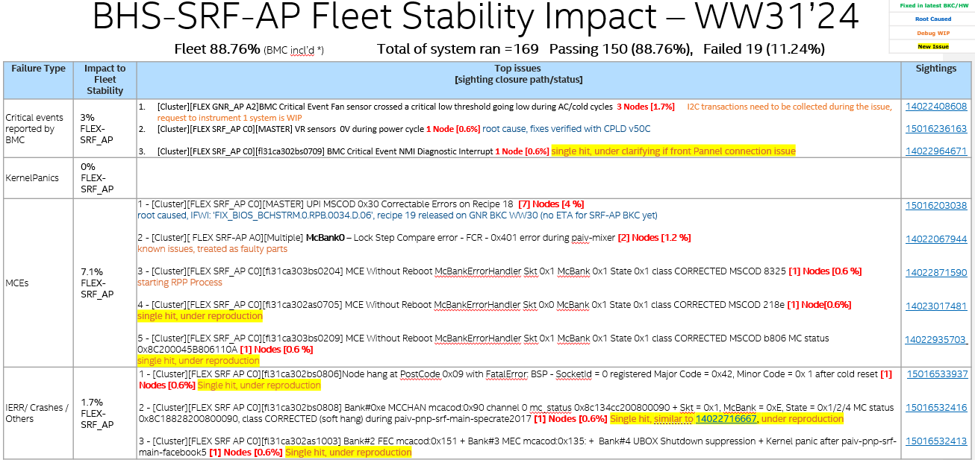

Slide 29
HC Demand for CSP Co-Val
HC Demand for CSP Co-Val v0.1
 | TWN ASV | 1CSP/50SUTs | 1CSP/250SUTs | 2CSPs/100SUTs | 2CSPs/500SUTs | Note
CSP Co-Val Engineering manager | 1 | 1 | 1 | 1 | 1
Validation Lead | 1 | 1 | 1 | 1.5 | 1.5 | Diff platform/ODM schedule
*L3 Debug | 1 | 6.5(5.5) | 6.5(5.5) | 6.5(5.5) | 6.5(5.5) | by domains within ASV scope
L1/L2 Triage | 2 | 1 | 4(2) | 2 | 8(6) | fail rate 10%, ~5 NRNs per engineer
*Content Arch | 0 | (0.5) | (0.5) | (1) | (1) | Test planning and scoping, TCs from CSPs
Orchestration | 2 | 1 | 3(1) | 2 | 6(4) | Execution, config pre-check need hands-on
Automation | 1 | 0.5 | 0.5 | 0.5 | 0.5 | Common pool
Data Science | 1 | 0.3 | 0.3 | 0.6 | 0.6 | Common pool
*Infra | 0 | (1) | (1) | (2) | (2) | Need input from Infra (telemetry, system assembly/config etc.)
Total | 9 | 12.8 | 17.8 | 17.1 | 27.1 | (X.X) is the gap for the current ASV TWN HC
Assumption
HC demand is estimated based on ASV validation scope/strategy
TWN ASV owns sysdebug roles including debug lead, CPU core, memory/RAS, PCIe/CXL, BIOS, BMC, DPMO(?) and OS/kernel
Automation and data science are working as comment support pool for each project
Demand for debug nodes ~5% needs is considered
Leverage L3 sysdebug roles across platforms
Typically, HC of triage engineers cannot be leveraged across platforms
* Identified as a skill or resource gap, expected to get dedicate support from outside of ASV TWN or allocate dedicate resource in ASV TWN

Slide 30
SRF-AP Transition Status Update (WW21)
PO
Beta
QS
PRQ
Meetings for Val Lead
No.​ | Meeting​ | Day​ | Time​ | Taiwan Time​ | Owner​ | Representation​ | Comments​ | Avinash Join?​ | BDC internal sync?​
1​ | SRF PXT​ | Wednesday​ | 8AM PST​ | Wed 11PM CST​ | Jafarzade, Farhad​ | Alex​ | Not attending all the times but when need to present I attend​ | Yes​ | No ​
2​ | BHS MisCo​ | Thursday​ | 9AM PST​ | Fri 12AM CST​ | Venkateshmurthy, Monika​ | Alex​ | Not attending all the times but when need to present I attend​ | No​ | Ram presents in this meeting​
 |  |  |  |  | Simonelli, Danielle M​
3​ | Cluster Spring Meeting​ | Monday​ | 8AM PST​ | Mon 11PM CST​ | DeGeer, Matthew​ | Alex​ | Every week attend​ | Yes​ | No ​
4​ | Updated PAIV EVF sync​ | Tuesday​ | 4PM PST​ | Wed 7AM CST​ | DeGeer, Matthew​ | Alex​ | Every week attend​ | No​ | No ​
5​ | SRF Product Execution Core Team​ | Tuesday​ | 1PM PST​ | Wed 4AM CST​ | Harter, Christopher C​ | Ram​ | Ram cover this. Not attending​ | No​ | No ​
6​ | Cluster Content Forum​ | Wednesday​ | 9AM PST​ | Thu 12AM CST​ | Kumar, Deepak1​ | Alex​ | Not attending all the times but when help is needed​ | Yes​ | Pradeep has a diff session for SRF​
7​ | GNR Cluster Syncup​ | Wednesday​ | 1:40 PM PST​ | Thu 04:40AM CST​ | Vemu, Ramtilak​ | Alex​ | Every week attend​ | No​ | ​
8​ | At-Scale Validation Cluster Forum​ | Thursday​ | 8AM PST​ | Thu 11PM CST​ | Narayanan, Bimod​ | Alex​ | Every week attend​ | Yes​ | Satish has an alignment in BDC in Thur morning​
9​ | SRF AP Allocation Meeting​ | Thursday​ | 12:35 PM PST​ | Fri 03:35AM CST​ | Redondo Lizano, Elmer​ | Alex​ | Every week attend​ | No​ | Ram attends the SRF-SP Allocation Meeting​
10​ | Cluster EVF Daily Huddle​ | Monday-Friday​ | 9:00 AM​ | 12 AM CST​ | Salvador Pinedo​ | Alex​ | Every day attend​ | Yes​ | ​

Slide 31
Test
test2

